Slide 1


COLUMBIA LAB-TO-MARKET
ADVANCED MATERIALS PRIZE
WITH CORNING INC.

Slide 2





COLUMBIA-CORNING ADVANCED MATERIALS PRIZE
The Columbia-Corning Advanced Materials Prize was founded in 2020 as a joint effort between Corning and Columbia University. We source promising advanced material technologies and startups from Columbia University research labs and dorms to build game-changing companies. All research labs across Columbia are eligible.
OUR PARTNERS
This program is administered by Columbia Lab-To-Market and the Columbia Materials Research Science and Engineering Center (MRSEC).

Slide 3
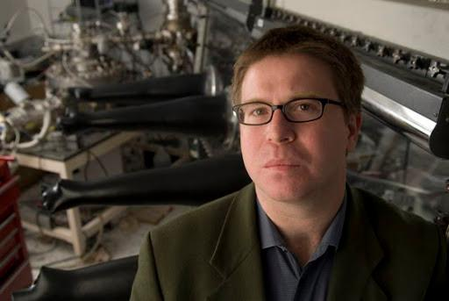
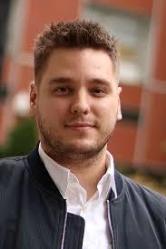
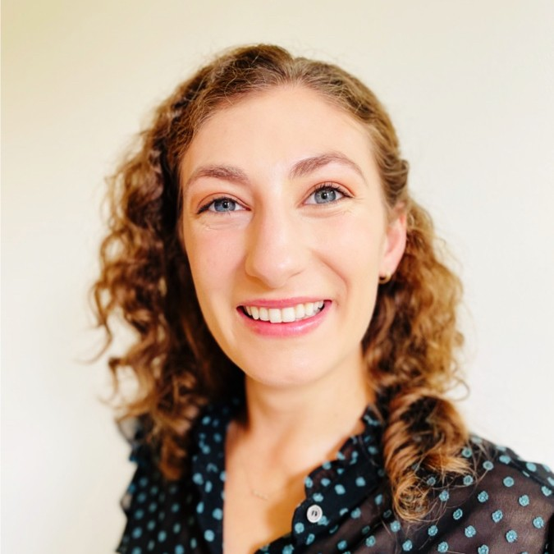
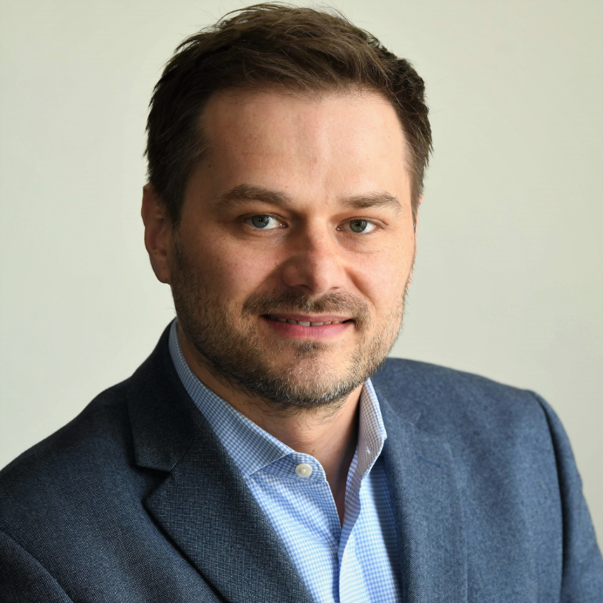
OUR TEAM
COLIN NUCKOLLS
JEFF DEMARS
AMELIA PACHT
DMYTRO POKHYLKO
CO-DIRECTOR
COORDINATOR
PROJECT MANAGER
DIRECTOR
MRSEC-COLUMBIA ENGINEERING, HIGGINS PROFESSOR OF CHEMISTRY
MRSEC-COLUMBIA ENGINEERING
INDUSTRY RELATIONS GROUP
COLUMBIA TECHNOLOGY VENTURES

Slide 4
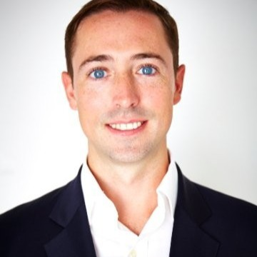
CORNING PARTNERS
RYAN FLANNERY
CORNING INC.

Slide 5
CORNING'S INVOLVEMENT
TECHNOLOGY REVIEW COMMITTEE
Corning’s team will be involved in our selection and review committee to gauge the commercial viability of projects.
MENTORSHIP
Corning’s R&D and business leadership will work with ventures accepted into the accelerator, participating in fireside chats, one-on-one office hours, and other showcases.
CORNING EQUIPMENT
Corning will provide their equipment and resources to selected ventures, when possible. This may include providing samples, prototypes or processing that is rare or very expensive in a variety of areas.
FUNDING
All prize funding will be provided by the Corning team and administered by Columbia. The Corning team will review our ventures’ progress and have the opportunity to work with high-potential team(s) beyond the accelerator’s conclusion.

Slide 6




OUR PROGRAM
Cohorts of 2-3 promising technologies go through a 12-week program where they receive:
Seed funding from Corning Incorporated: All selected projects receive $2k, while finalist receives $50k
Access to extensive mentor network with deep technical and entrepreneurial experience
Connections to the Corning’s research and development leadership and cutting-edge equipment
Lean LaunchPad and entrepreneurial sessions specific to advanced materials

Slide 7
OUR ECOSYSTEM
Columbia Materials Research Science and Engineering Center (MRSEC)
COLUMBIA-CORNING ADVANCED MATERIALS ACCELERATOR
Columbia Engineering
Columbia Arts and Sciences
Columbia Nano Initiative
Columbia Quantum Initiative
Columbia Data Science Institute

Slide 8
WHO WE ARE LOOKING FOR
EARLY STAGE ADVANCED MATERIALS TECHNOLOGIES AND STARTUPS
We're searching for a broad range of early-stage translational projects, from research to pre-seed startups.
AFFILIATED WITH COLUMBIA UNIVERSITY
One of the team members must be a faculty, student, fellow, or staff member at Columbia University. Eligibility may expand in the future.
COMMIT TO PERIODIC ENTREPRENEURIAL SESSIONS
Up to 5 sessions during the spring semester, including meetings and mentor conversations with Corning and fellow teams, and periodic networking events.
Entrepreneurial sessions are optional but encouraged.

Slide 9
FOCUS AREAS
MATERIALS FOR QUANTUM COMPUTING
ADVANCED COATINGS AND PAINTS
Application areas include new technologies for quantum memory, quantum communication.
Applications include advanced windows, bio-active coatings, novel optical coatings, super hydro and oleophobic
CERAMIC MATERIALS
BATTERY TECHNOLOGIES
Application areas include RF electronics, energy storage, and filtration of gas and liquids.
Applications areas include solid state batteries, silicon anode technologies, flexible batteries, novel energy storage concepts.
MATERIALS, EQUIPMENT,AND SYSTEMS FOR LIFE SCIENCES
PHOTONIC AND DISPLAY TECHNOLOGY
Application areas include LED/OLED displays, thin films for electronics and optoelectronics, microLED technologies, holographic and light field technologies, flexible displays, transparent displays, near eye displays, novel backplanes and driving electronics.
Application areas include cell/gene therapy, cell and organoid culture technologies, sorting and separations technology, lab automation technology, imaging, diagnostics, microfluidics, high throughput synthesis of DNA/RNA.

Slide 10
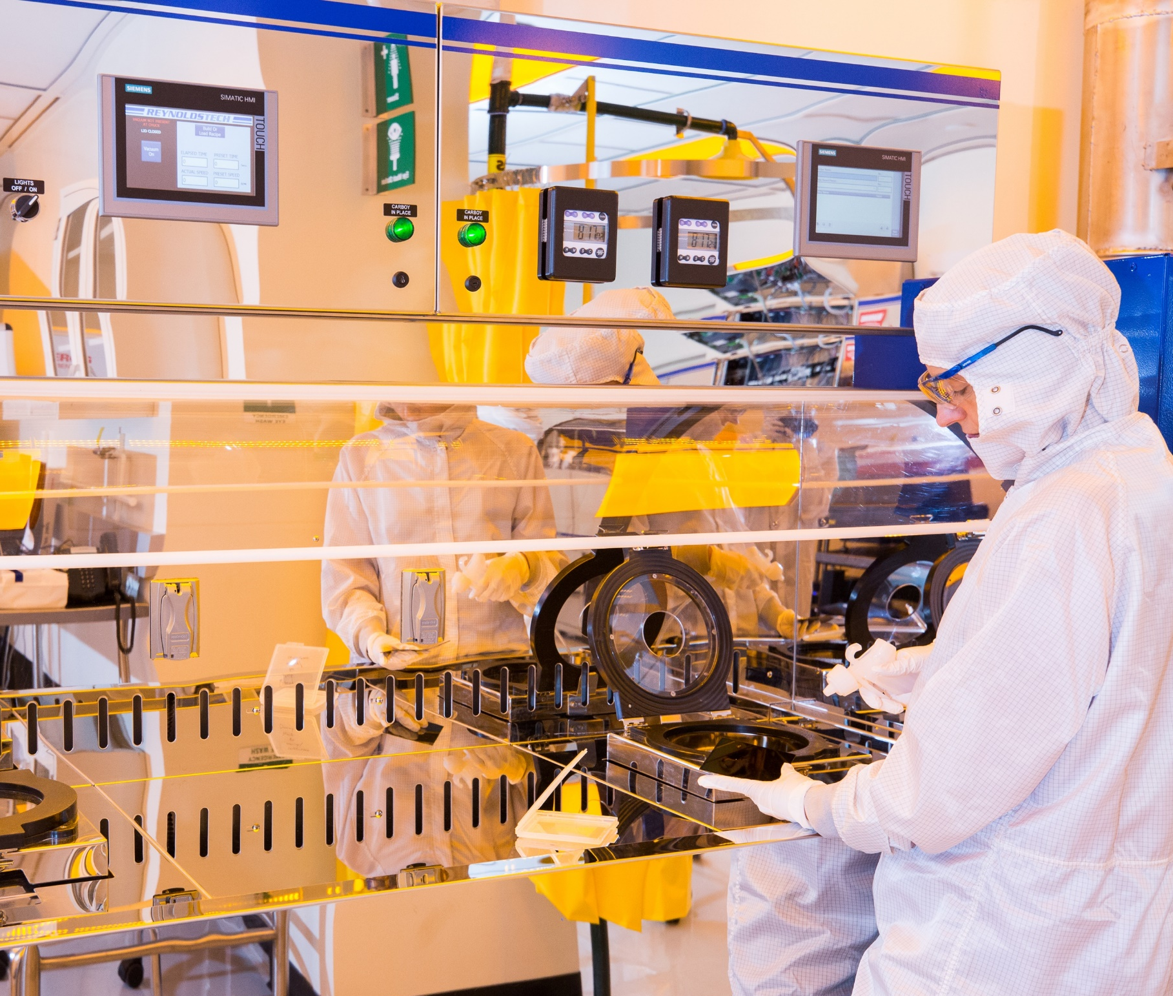
ADDITIONAL FOCUS AREAS
Optical communications
1D-2D-3D polymer
Phase change materials
Roll-to-roll processing of novel systems
mmwave and terahertz technologies
Y-doped crystals
Novel catalysts

Slide 11
PROPOSAL: WHAT WE'RE LOOKING FOR
TEAM
PROBLEM
What is your team composition and expertise?
What problem are you solving and what markets are you targeting?
TECHNOLOGY
COMMITMENT
Provide a non-confidential overview of your technology and current state of its development.
Can your team participate in 2-5 sessions (1-4 hours per session) during the spring semester?
The application should take under 1 hour to complete.

Slide 12
TIMELINE & FUNDING
Optional Lean Launchpad sessions
Winner of Corning prize announced
Pre-proposals due
Teams selected and accelerator begins
Speakers series, other events
Accelerator showcase
FEB 2022
MAR 2022
APR 2022
MAY 2022
JUN 2022
All selected semi-finalist teams receive $2k
Winning team receives additional $50k
Winning team will pursue continued and deepened collaboration with Corning. Remaining accelerator teams will be supported through introductions to mentors, advisors and potentially investors, as appropriate.

Slide 13
FREQUENTLY ASKED QUESTIONS
HOW LONG WILL IT TAKE TO COMPLETE THE APPLICATION?
The application should take less than an hour to complete.
CAN MY TEAM INCLUDE MEMBERS FROM OTHER INSTITUTIONS?
Yes! We only require that at least one team member be a faculty, student, fellow, or staff member at Columbia University.
HOW MANY SESSIONS TO MY TEAM HAVE TO ATTEND?
There are 5 optional entrepreneurial sessions throughout the semester. Attending the Kickoff and Demo Day events is required.
WHAT MATERIALS DOES CORNING SUPPLY?
Corning is offering both their resources and equipment to select ventures. For example, Corning may provide samples, prototypes or processing that is rare or very expensive in a variety of areas.
There will be an optional information session on Thursday, February 3rd, 2022 in which Corning and Columbia representatives will field questions about the program and application process.

Slide 14

CONTACT US
Amelia Pacht
Amelia.pacht@columbia.edu
http://bit.ly/CU-CorningAccelerator
Applications are due Monday, February 14, 2022

